Slide 1
ME-212 ASSIGNMENT
Created by group no. 4 consisting of members-
1) SHUBHAM RAJ
2) M. ANUBHAV RISHIKESH
3) SANJIB MEDHI
4) PIYUSH CHANDRAKANT KULKARNI

Slide 2
DISCUSSION OF RESEARCH PAPER
Name of the paper:
An Analogy Tool to Visualize Bending-Moment Diagrams.
Authors:
Dr. Gustavo O. Maldonado. (Masters and Ph.D. , Virginia Tech)
2) Dr. Gustavo J. Molina. (Ph.D. , Virginia Tech)

Slide 3
INTRODUCTION
This work focuses on the use of an analogy that facilitates the visualization of bending-moment diagrams for the analysis of simple beams. The determination of shear diagrams is, usually, a straightforward task. On the other hand, the generation of moment diagrams requires more effort and may present some challenges for the students. The objective of this article is to present an old, but not widely known or used, educational tool that allows students to use a simple analogy to visualize the shape of moment diagrams. This a-priori visualization helps to minimize errors during a more rigorous determination of the diagrams, or it can be used to check the general shape of already determined diagrams.

Slide 4
THE PURPOSE OF THIS PAPER
The paper discusses an analogy tool that can help students in visualizing the bending moment diagrams for given loading on a beam, by using a simple analogy called the chain analogy.
The analogy possesses a mathematical base. Two similar ordinary differential equations govern two different equilibrium-based problems in Statics.
One involves bending moments in beams, and may present some learning difficulties to students. The other involves the displaced equilibrium configuration of a loaded chain, and may be intuitively visualized.
This article compares the two governing equations and indicates the conditions under which both equations become numerically equivalent. It presents the proper use of the analogy to visualize solutions in chains that can be used to generate the corresponding bending moments in beams.

Slide 5
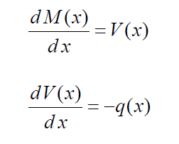

The Chain Analogy
Differential Equation for Bending Moments:
Satisfaction of equilibrium conditions produces the load-shear-moment relations. They are differential equations involving the distributed load q(x), the shear force function V(x) and the bending moment function M(x). They are described in most Statics textbooks using the following notation:
where the longitudinal direction of the beam is horizontal, along the x-axis, and q(x) is
vertical, but distributed horizontally along the longitudinal x-axis of the beam. In these
equations, q(x) is considered positive if it acts downward. The effects of positive shear
and positive bending-moment, on a small segment of the beam, are presented in the figure.
From the equations above, we obtain the equation-

Slide 6
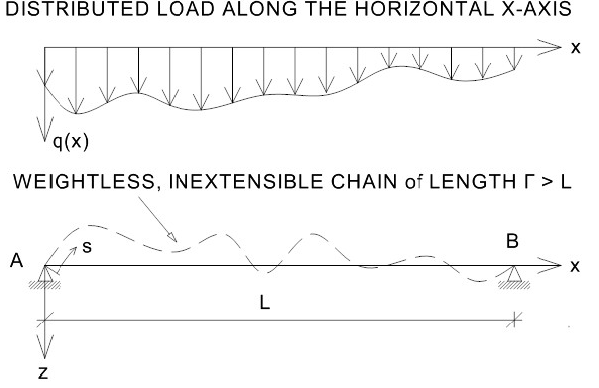
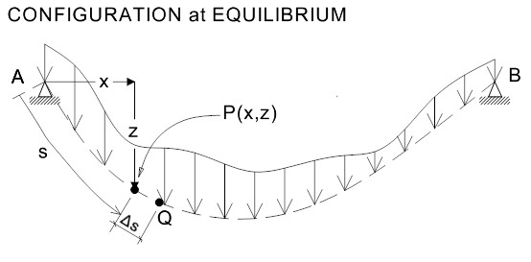
Differential Equation for the Profile of a Weightless, Inextensible Chain
Consider a weightless, inextensible chain, of length Γ > L. This chain has total flexural flexibility, but it is axially
rigid. Oftentimes, it is referred to as a flexible, inextensible chain (or cable). Also, consider that its first and last
links are attached to fixed supports A and B, which are at the same level, as shown in Figure 2. The end links can
freely rotate about supports A and B. The horizontal distance between supports is L. The chain is subjected to a
vertical load, q(x), distributed along the horizontal x-axis (not along the length of the chain). The attained
equilibrium configuration is sketched in Figure 2. An arbitrary point P, of the chain, is shown in the equilibrium
configuration. It is located at coordinates (x, z).
FIGURE 2

Slide 7
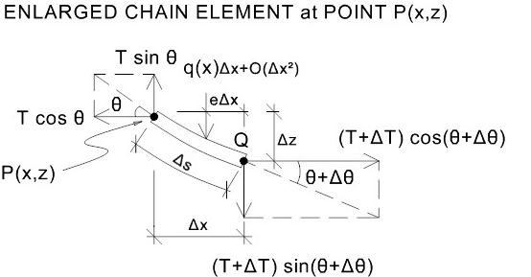

The figure shows the free-body diagram of an incremental element of chain, from P to Q. It has tangential tensional forces, T and T+ΔT, acting at P and at Q, respectively. Only the horizontal and vertical components of those tangential forces are indicated. The external force acting on the element is represented by a single vertical force at a distance (e Δx ) from point Q, with 0<e<1. The magnitude of this force is q(x)Δx + O(Δx^2). Where O(Δx^2) represents a term of order (Δx)^2.
In this element, the equilibrium of forces along the horizontal direction yields:
(T + ΔT) cos(θ + Δθ ) − T cos θ=0 –(i)
After dividing this expression by Δx, and taking the limit as Δx→0, we obtain:
(dTcosθ/dx) = 0 -(ii) .
That is, the horizontal component of the tensional tangential force T is constant along the chain. This constant value is here designated as:
H = Tcosθ . The equilibrium of forces along the vertical direction, z, results in:
(T + ΔT) sin(θ + Δθ ) − Tsin θ + q(x) Δx + O(Δx2)=0 –(iii)
Dividing the above equation by Δx, and taking the limit asΔx→0, yields:
$\frac{dTsinθ}{dx}=−q(x$) -(iv)
Similarly, as Δx→0, the limit of the equation of equilibrium of moments about point Q, produces: (dz/dx) = tanθ

Slide 8
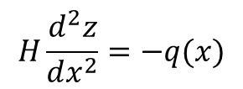
From the obtained equations, we can get the second degree equation:
$$H\frac{d^{2}z}{dx^{2}}=−q(x)$$
The above second degree equation is the differential equation governing the vertical profile, z(x), of a weightless, inextensible chain at equilibrium under a vertical load q(x) distributed along the horizontal x-axis.
Constant H is the horizontal component of the internal tensional force existing at any point of the chain at equilibrium.
The value of T may change from point to point, but H remains constant. The value of H depends on the load
function q(x), on the length between supports L, and on the total length of the chain Γ (with Γ>L)

Slide 9
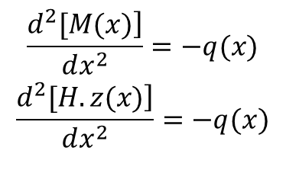
Analysis of the Analogy
The equations for bending moment and for the vertical profile of a weightless inextensible chain under a vertical load q(x) distributed along the horizontal x-axis are obtained as follows:
$$\begin{matrix}\frac{\left.d^{2}[M(x)\right]}{dx^{2}}=−q(x) \\ \frac{\left.d^{2}[H.z(x)\right]}{dx^{2}}=−q(x) \\ \end{matrix}$$
Both expressions are linear, non-homogeneous, second order, ordinary differential equations. They both contain
one second derivative term and the same forcing term. Both were derived by satisfying equilibrium conditions.
They involve different quantities within the square brackets, but those quantities, M(x) and H z(x), are dimensionally
equal.
By using the same dimensional units in both equations, and by selecting an appropriate length Γ>L for the chain,
the horizontal component H of the tensional force may become equal to a unit force. In that case, the numerical
values of the vertical ordinates z(x) of the chain will coincide with the numerical values of the bending moments
M(x) of the beam. Even if the constant H were not equal to 1, the vertical profile of the chain will still be similar to
the corresponding bending-moment diagram, but numerically different.

Slide 10
USE OF THE ANALOGY
Example 1: Simply supported beam with end supports at point A and B. Its total length is L and its uniformly distributed load is q(x) = q. The weightless, inextensible chain to be used in the analogy is shown on the right-hand side of the figure. Supports
A and B are at the same level and must be separated by a distance equal to the total length L of the beam. The loads
on the chain must be the same as those on the beam. The length of the chain may be any length Γ > L.
After visualizing the chain attached to its supports, one may also visualize the acquired shape of the loaded chain at equilibrium. The symmetric image of that shape, with respect to the x-axis, should be similar to the shape of the bending-moment diagram. The need to obtain that symmetric image arises from the fact that positive values of the profile are plotted below the x-axis, and positive bending moments are plotted above the x-axis.
By using an appropriate length of chain, its profile at equilibrium should be the same as the bending-moment
diagram. The bending moment at middle point of the beam can be obtained from the available shear-force function (diagram). It may be integrated, from its origin to the selected point, or we may just calculate the area under its curve between those two points.

Slide 11
That calculation produces qL^2/8. Hence, the lowest point of the profile must have an ordinate equal to qL^2/8 to be the same as the bending-moment diagram.
After this calculation, we know the approximate shape of the profile and the position of three of its points: A, B and the selected mid-span point.
Adjustments can now be made to produce the second profile shown in the figure. This one has the appropriate length of chain and its symmetric image (with respect to the x-axis) should be similar to the actual shape of the bending-moment diagram.
Consider the chain with the proper length. By solving the equilibrium equations corresponding to one full half of
this chain, it can be shown that H=1. Also, those solutions show that the vertical components of the reactions for
the chain coincide with the vertical reactions for the beam and, as expected, the horizontal components of the
reactions for the chain are H=1. The beam has no horizontal reactions.

Slide 12
Example 2: Simply-supported beam with a concentrated load P at a distance a from the left support:
The right-hand side of the figure shows a weightless, inextensible chain supported by hinges A and C at a distance L
from each other. Consider that this chain has an arbitrary length Γ > L. The same load P acting on the beam is
applied on the chain. It acts along a vertical line at a distance a from the left support.
The equilibrium profile of the chain under this load can be easily visualized. The shape of the symmetric image of this profile should be similar to the shape of the bending moment diagram. However, since the length of the chain was arbitrarily selected, the vertical distances measured along the profile, may not coincide with the values of the bending moment. This coincidence is attained only when an appropriate length of chain is used. Such length makes the horizontal component of the internal tensional force to be equal to 1 (H =1). The appropriate length can be determined by using equilibrium equations.

Slide 13
Example 3: simply-supported beam with a concentrated moment M.
A concentrated moment causes a step in the bending moment diagram. The vertical length of the step is equal to the magnitude of the moment. This example shows how the chain analogy can be used to properly visualize the effect of concentrated moments.
The corresponding weightless, inextensible chain is shown on the right-hand side of the figure. Supports A and C are at the same level and separated by a distance L. Moment M is applied at the same location that it acts on the beam. Since a concentrated moment causes a step in the bending-moment diagram, the equilibrium profile of the loaded chain should be able to show this effect. For this purpose, the chain has to be slightly modified. It must contain a long rigid link at the location of moment M. The length of this link should be equal to the magnitude of moment M. Initially, the long link should be accommodated horizontally in the unloaded, loose chain. Once the chain is attached to its supports, moment M is applied to the long link. If the chain were of the proper length, moment M should cause the long rigid link to rotate (in the direction indicated by the applied moment) and attain a vertical position at equilibrium.

Slide 14
Example 4: This example shows a simply-supported beam with overhang. The total length of the beam is L.
Even though the distance between the beam supports, points A and C, is (2/3)L, the supports for the chain, points A and D, must still be separated by the total length L of the beam.
The loads applied on the chain are the same as those acting on the beam. However, in this case, an additional force has to be applied on the chain. That force is the beam reaction at support C. Since the chain has no support at C, the beam reaction at C must be considered as a load on the chain at point C.
A qualitative visualization of the bending-moment diagram is attained in the same fashion as described in the previous examples. The visualization of the shape with the proper dimensions can be assisted by calculating the bending moments at points B and C of the beam.

Slide 15
Example 5: Cantilever beam with uniformly distributed loading:
The total length of the beam is L. Even though this beam is supported only at point B, the chain, as required by the analogy, will be supported at both end points, A and B. They are separated by a distance equal to the total length of the beam L.
The beam has a reactive moment at point B, M = qL^2/2. This moment is considered in the chain as a concentrated moment applied at point B. A long rigid link must be incorporated in the chain to properly model this concentrated moment. In this case, the long link will be the end link of the chain and should be attached to support B. The proper length of this link should be equal to the magnitude of the moment M = qL^2/2.
Initially, the loose chain should contain the long link in the horizontal position. The long link should be rotated in the direction indicated by moment M and should attain a vertical position. Then, the distributed load should be applied to the chain. If the proper length of chain is used, the equilibrium configuration will correspond to the vertical position of the long link. The symmetric image of that chain profile should coincide with the bending moment of the beam.

Slide 16
CONCLUSION
This work presented the use of an analogy that assists in the generation of bending-moment diagrams in beams. This Chain Analogy is based on two similar differential equations describing two different equilibrium problems in Statics.
One of them can be easily visualized and is used to assist in the solution of the other. The shape of bending-moment diagrams, in transversally loaded beams, is analogous to the shape of the vertical profile, at equilibrium, of a weightless, inextensible chain with the same loadings that affect the beam.
Several examples were presented to illustrate the proper use of details that need to be considered in the chain so its visualized profile is similar to the moment diagram of the corresponding beam.
Also, it is shown that the profiles of chains with proper lengths are exactly the same as the moment diagrams of the corresponding beams. Chains with that appropriate length have the horizontal component of their tensional forces equal to a unit force.

Slide 17
REFERENCES
[1]Beer, Ferdinand, Russell Johnston and Elliot Eisenberg, Vector Mechanics for Engineers, Statics, McGraw-Hill, New York, 2004.
[2] Farhey, Daniel, Conceptual Visualization of Moment Diagrams for a Simply Supported Beam, Webpage:
http://academic.udayton.edu/DanielFarhey/mconcept.htm, 2002.
[3] Hibbeler, R.C., Engineering Mechanics, Statics, Prentice Hall, New York, 2001.
[4] Irvine, H. Max, Studies in the Statics and Dynamics of Simple Cable Systems, Thesis, California Institute of Technology, Pasadena,
California, 1974.
[5] Irvine, Max, Cable Structures, Dover Publications, New York, 1992.
[6] Meriam, James and Glenn Kraige, Engineering Mechanics, Statics, John Wiley & Sons, 2002.
[7] Miller, Gregory and Stephen Cooper, Visual Mechanics: Beams and Stress States, Software Package,
Wadsworth/ITP, 1998.
[8] Truesdell, Clifford, III, The Rational Mechanics of Flexible or Elastic Bodies 1638-1788, L. Euleri Opera
Omnia, series II, vol. II, part 2. Zurich: Fussli, 1960.

Slide 18
THANK YOU!

